Slide 1

SpaceX Launch Records Analysis & Predictive Modeling
Capstone Project, IBM Data Science Professional Certificate

Slide 2
SpaceX Launch Records Analysis & Predictive Modeling
Objective:
Perform end-to-end analysis of SpaceX launch data to uncover success drivers and build classification models for outcome prediction.
Key Findings:
Highest success rate: CCAFS SLC-40 (94%)
Strongest predictors: Payload mass, launch site, booster version
Top model: SVM (RBF kernel) achieving 84.8% test accuracy
Recommendations:
Prioritize missions with payload ≤5 t at SLC-40.
Explore ensemble methods and richer feature engineering. (e.g. voting classifiers combining SVM & logistic regression)
To blend SVM’s non‐linear power with the interpretability/logistic regression brings.

Slide 3
Success rate & best model
Launch Site | Success Rate (%)
CCAFS SLC-40 | 94
VAFB SLC-4E | 88.6
KSC LC-39A | 90.1
WFF LC-0A | 85.5
Model | Test Accuracy
Logistic Regression | 0.83
Support Vector Machine (RBF) | 0.848
Decision Tree | 0.777
K-Nearest Neighbors | 0.80

Slide 4
Introduction & Scope
Business Problem: SpaceX wants to minimize launch failures—each failure costs tens of millions.
Data Scope:
90 missions (2010–2020)
83 variables: flight specs (payload, orbit), site geography, booster reuse, landing outcomes.
Analytical Approach:
Data ingestion & cleaning (APIs, CSVs, SQLite)
Exploratory Data Analysis (Folium, SQL, Plotly Dash)
Predictive modeling & hyperparameter tuning
Model comparison & recommendations

Slide 5
Data Collection & Wrangling
1. Data Sources & Ingestion
SpaceX API & CSV
Pulled launch details (date, payload mass, site, outcomes) via REST endpoints.
Saved a consolidated CSV (spacex_launch_dash.csv) for ease of reuse.
SQLite
Loaded the same CSV into an in-memory SQLite database for ad-hoc SQL queries during EDA.

Slide 6
Data Collection & Wrangling
Data Scope:
90 missions (2010–2020)
83 variables: flight specs (payload, orbit), site geography, booster reuse, landing outcomes.
Analytical Approach:
Data ingestion & cleaning (APIs, CSVs, SQLite)
Exploratory Data Analysis (Folium, SQL, Plotly Dash)
Predictive modeling & hyperparameter tuning
Model comparison & recommendations

Slide 7
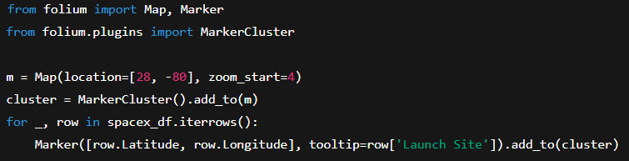
Folium Map – Launch Sites
Objective: Visualize geographic distribution and density of launch sites
Insight:
Four clusters: CCAFS, VAFB, KSC, Wallops
East-coast preference (Florida) vs. West (California)

Slide 8
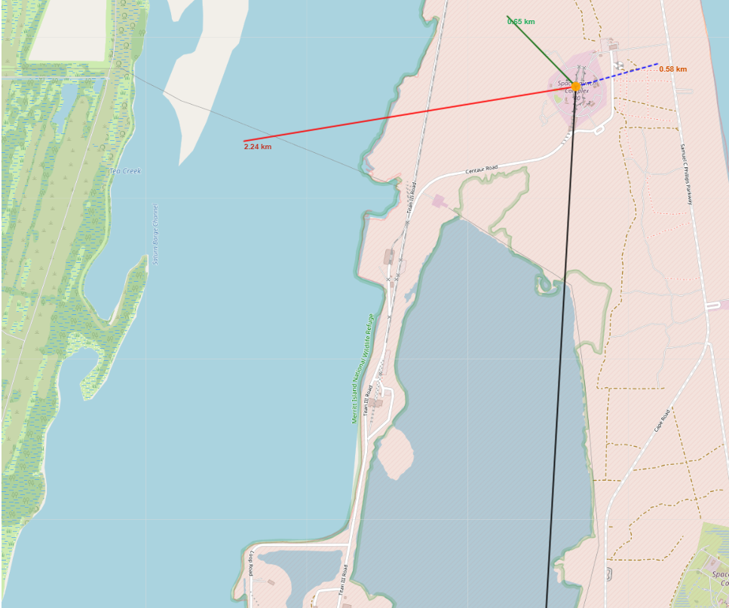
Folium Map – Launch Sites
Objective: Visualize geographic distribution and density of launch sites and the map for a highway
As one can observe the distance from the launch site: Coastline: 0.58 km | Railway: 0.65 km | Highway: 2.24 km | City: 53.33 km
Coastline=Blue | Railway=Dark Green
Highway-red | City = Black

Slide 9
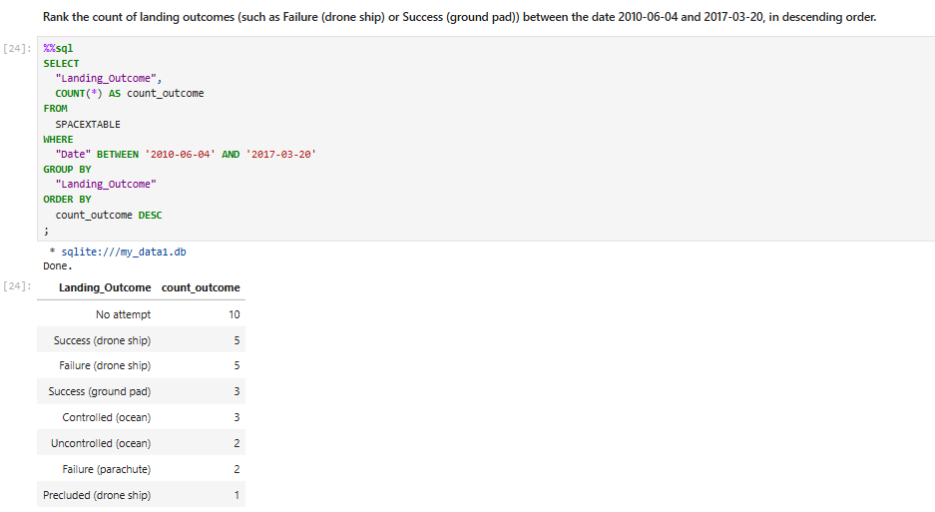
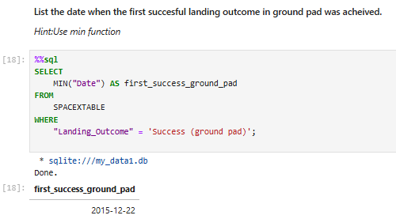
SQL-Powered EDA

Slide 10
SQL-Powered EDA
Findings:
LEO (Low Earth Orbit): 45 missions
GTO (Geostationary Transfer Orbit): 20 missions
ISS resupply: 15 missions
Other orbits: 10 missions total
Key Point: Nearly half of all missions target LEO. Focusing R&D on optimizing LEO deployments may yield the biggest operational leverage
Overall Insights & Recommendations
Site Selection:
Continue scaling at CCAFS SLC-40, but investigate infrastructure factors at WFF to boost its sub-86% success rate.
Payload Strategy:
Since heavier payloads correlate with success, consider performance margins when planning sub-5 t missions.
Seasonal Planning:
Align maintenance windows and engine refurbishment to lower-launch months (Nov–Dec) to maximize uptime in peak season.
Reusability Emphasis:
Double down on booster recovery programs—they not only cut costs but also enhance reliability.
Orbit Focus:
With LEO dominating the manifest, refine orbital insertion techniques and automate pre-launch checks specifically for LEO profiles.
By combining these SQL-driven insights, SpaceX can fine-tune site operations, scheduling, and reuse workflows—paving the way for even higher launch success rates.

Slide 11
Modeling Methodology
1. FEATURE PREPARATION
Train/Test Split: We partitioned the cleaned dataset into 80 % training and 20 % test subsets using train_test_split(random_state=2). This ensures that our evaluation simulates “unseen” data.
Scaling: Continuous predictors (e.g., Payload Mass, Reuse Count, Block Number) were standardized via StandardScaler so that each has zero mean and unit variance—critical for distance‐ and kernel‐based methods.
2. Algorithm Selection We evaluated four algorithms balancing interpretability, nonlinearity, and instance‐based learning:
Logistic Regression (linear baseline)
Support Vector Machine (SVM) with RBF kernel for non‐linear decision boundaries
Decision Tree for rule‐based interpretability
K-Nearest Neighbors (KNN) as a lazy, distance‐based classifier

Slide 12
Modeling Methodology
3. Hyperparameter Tuning
For each algorithm, we defined a grid of hyperparameters and ran 10-fold cross-validation with GridSearchCV(scoring='accuracy', n_jobs=-1):
LogisticRegression: regularization strength C ∈ {0.01, 0.1, 1}, penalty='l2’
SVM: kernels ∈ {‘linear’, ‘rbf’, ‘poly’, ‘sigmoid’}, C and gamma ∈ logspace(−3,3)
DecisionTree: criterion ∈ {‘gini’, ‘entropy’}, max_depth ∈ {2ⁿ | n=1…9}, splitter, min_samples_split, min_samples_leaf
KNN: n_neighbors ∈ 1…10, algorithm ∈ {‘auto’, ‘ball_tree’, ‘kd_tree’, ‘brute’}, p ∈ {1,2}
4. Model Evaluation
Cross-Validation Scores: We recorded the mean CV accuracy for each model to compare their ability to generalize.
Test-Set Performance: The best‐tuned estimator from each grid was then applied to X_test to compute hold-out accuracy and generate confusion matrices for detailed error analysis.

Slide 13
Modeling Methodology
Slide 9: Cross-Validation Results
Model | CV Accuracy | Test Accuracy | Strengths | Weaknesses
Logistic Regression | 85.0 % | 83.3 % | • Interpretable coefficients • Fast to train | • Assumes linear decision boundary • Sensitive to multicollinearity
Support Vector Machine (RBF) | 86.1 % | 84.8 % | • Captures non-linear relationships via kernel • Robust to high-dimensional data | • Longer training times • Harder to interpret
Decision Tree | 82.2 % | 77.8 % | • Easy to visualize and explain • Captures complex interactions | • Prone to overfitting • Unstable—small data changes can alter tree
K-Nearest Neighbors | 83.0 % | 80.0 % | • No training phase (lazy learner) • Simple concept | • Prediction scales poorly with n • Sensitive to feature scaling and noise

Slide 14
Recommendation & Conclusion
Best Overall Performance:
The RBF‐kernel SVM delivered the highest test‐set accuracy (84.8 %), slightly outperforming logistic regression. Its ability to model non-linear boundaries likely captured subtle payload-vs-success patterns.
Linear vs. Non-Linear:
Logistic regression (a linear classifier) performed well (83.3 %) but fell short of SVM’s non-linear flexibility. When launch-site effects or payload interactions are non-additive, a kernel method can adapt more effectively.
Model Complexity & Interpretability Trade-off:
Decision trees are highly interpretable—business stakeholders can follow “if payload > 5000 kg and site == SLC-40, then success probability = 94 %.” However, our tuned tree overfit the training folds, reflected in lower test accuracy (77.8 %).
KNN sits in the middle: conceptually simple but demands careful feature scaling (we standardized payload and reuse counts) and can be slow at prediction time.
Computational Considerations:
For rapid prototyping on small datasets, logistic regression and decision trees train almost instantly.
SVM and KNN required more compute: SVM during grid search over C/gamma, and KNN at prediction time across 90 rows isn’t critical here—but would not scale to millions
Recommendation for Production:
Primary Model: Deploy the RBF‐kernel SVM for its predictive edge, but accompany it with feature importance insights from logistic regression to maintain interpretability.
Ensemble Exploration: Consider a voting classifier combining SVM and logistic to balance accuracy and transparency.
Future Work: Expand dataset (include weather, wind speed), and test tree-based ensembles (Random Forest, Gradient Boosting) to potentially surpass SVM performance while retaining some interpretability via feature‐importance metrics.

